Slide 1

Department of Computer Science & Engineering
Classification of COVID-19 Using Chest X-ray
Date: 13 May 2021
P. MEGHANA :17WH1A0504
J. AMULYA SAI : 17WH1A0517
B. UDAYA SREE : 17WH1A0520
Internal Guide: Ms. P. KAVITHA
Designation : Assistant Professor
BVRIT HYDERABAD College of Engineering for Women

Slide 2

Why Should I Study this course?
ABSTRACT
Examples
In the current situation where we are it is very important to know covid test results as early as possible and some countries are unable to purchase laboratory kits for testing covid,so we are proposing a method which gives the results faster by taking chest x-ray images of patients as input.
In this project,firstly we have to train our model with chest x-ray images of covid positive persons and chest x-ray images of covid negative persons.This model is built using convolutional neural networks.Because CNN is a deep learning algorithm which can take an input image, assign importance to various aspects in the image and be able to differentiate one from other.
BVRIT HYDERABAD College of Engineering for Women

Slide 3

DATASET
The dataset contains images which belong to two different categories,i.e covid positive patient images and covid negative patient images.
The training dataset contains two category images and also the testing dataset contains images of two categories.
And the trained model is given a chest x-ray image as input and this model will predict whether the patient whose x-ray is given as input to the model is having covid or not.

Slide 4
ARCHITECTURE
Loading of chest x-ray images(data set)
Data Preprocessing
Building CNN Model
Prediction on New Data
Testing the Model
Training the Model

Slide 5
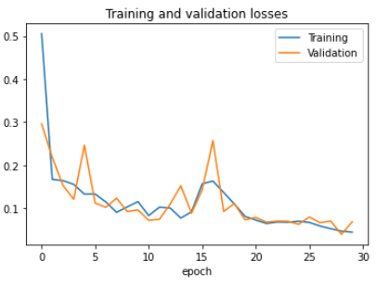

Slide 6
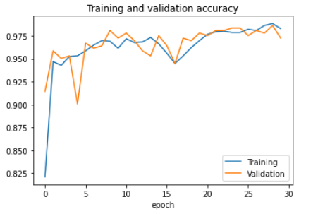

Slide 7

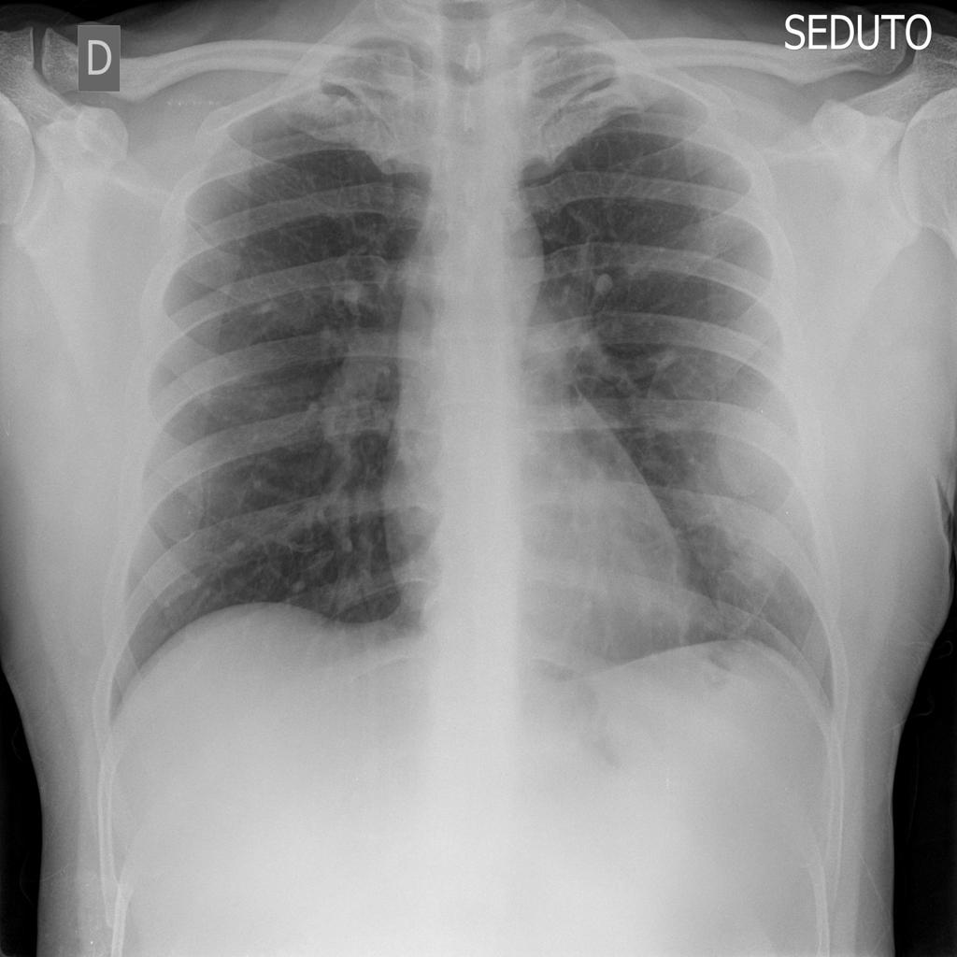
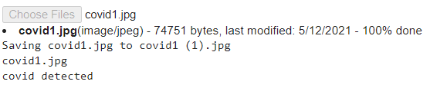

Slide 8

SYSTEM REQUIREMENTS
ENVIRONMENT | SPECIFICATIONS
HARDWARE | Processor - Intel core i5 Memory(RAM) - 8GB Storage - 1 TB
SOFTWARE | OS - Windows 10 / Ubuntu Google Colab / Jupyter Notebook
BVRIT HYDERABAD College of Engineering for Women

Slide 9
TIMELINE
Review 0 | Abstract Base paper and References
Review 1 | Software Requirements Gathering of Data Architecture Base paper and References
Review 2 | Review-i slides Partial implementation of features
Review 3 | Complete implementation Results & Discussions
 | Report of the Project

Slide 10
REFERENCES
https://www.kaggle.com/paultimothymooney/chest-xray-pneumonia
https://github.com/ieee8023/covid-chestxray-dataset/tree/master/images
https://github.com/education454/datasets
https://journals.sagepub.com/doi/10.1177/2472630320958376

Slide 11
THANK YOU

